Slide 1

Welcome to Year 2!
Notes:
Include some images for your year group

Slide 2


The Team
Year Leader: Miss Mulholland
Class Teachers:
2SP: Miss Mulholland
2SA: Mrs Middleton
2SG: Mr Brett and Miss Winbolt
2SD: Miss Brown
Support staff: Mrs McFarlane, Mrs Hunt, Mrs D’Silva, Mrs Sharma, Mrs Kaur, and Mrs Nanra

Slide 3
Our day
Mornings: Celebration of the Word, Maths, English, Handwriting, and Mastering Number.
Afternoons: Reading and Foundation subjects.
PE Days:
Monday: 2SP, 2SA, and 2SD
Tuesday: 2SG

Slide 4
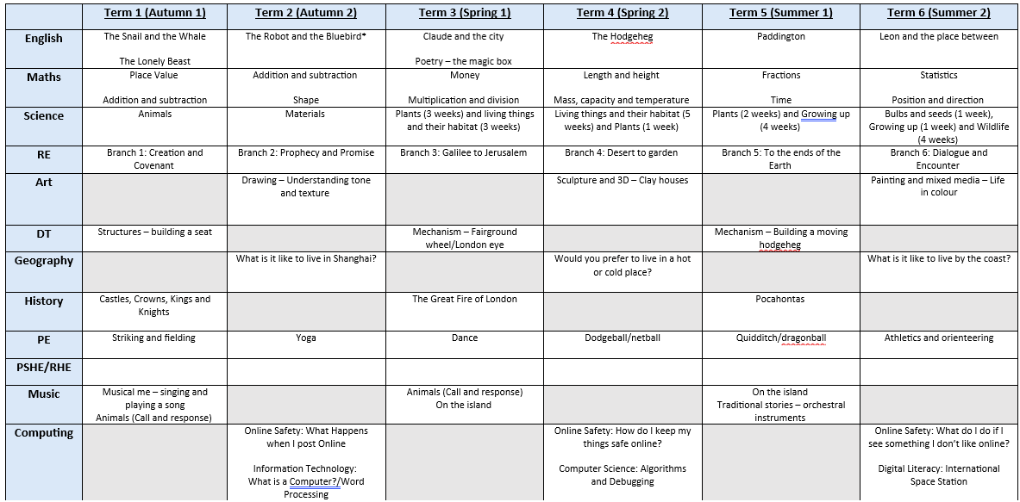
What will your children
be learning this year?

Slide 5
Homework and
daily reading
In Year 2, homework is given out on a Friday and returned the following Wednesday.
Children are expected to read daily with an adult and have their reading records signed to reflect this. reding books and reding records should be brought to school each day.
Children are asked to complete one Maths and one English activity each week. Children should also access Numbots for 10 minutes a week. The children will be given a spelling list of 10 words to practise what they have been learning in their phonics lessons.
Homework club will be on a Tuesday by invitation.

Slide 6
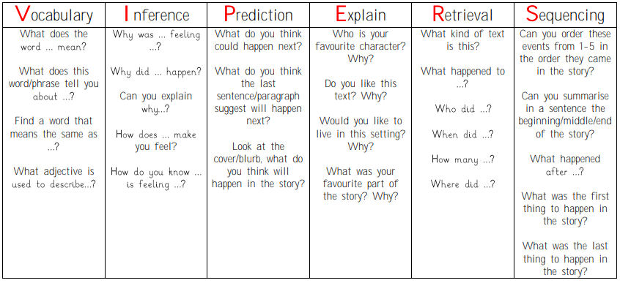
Please make sure your child is reading at home every day. This does not need to be the whole book.
Some questions you can ask your child to help develop their comprehension skills:

Slide 7
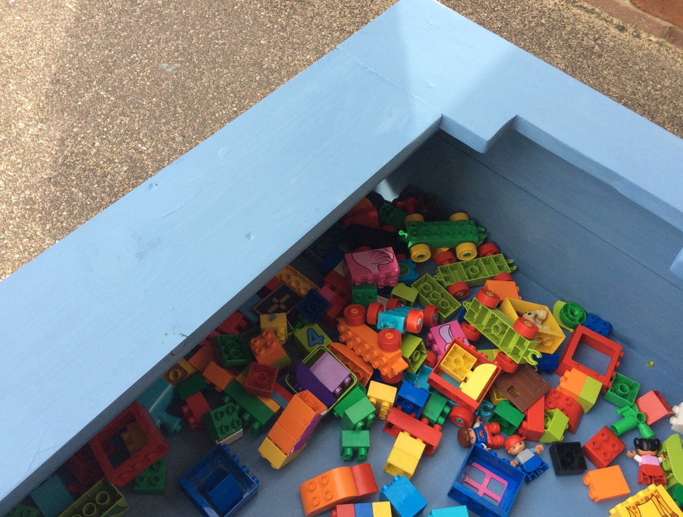
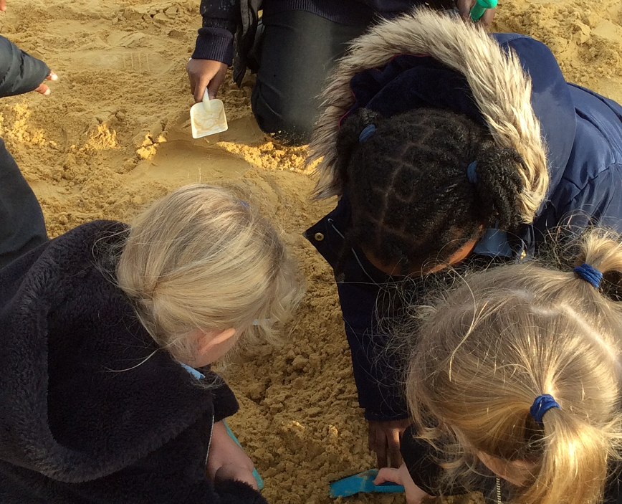
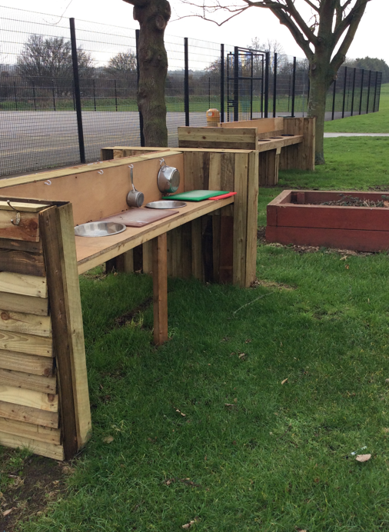
OPAL
At lunchtime, children are able to choose different areas to play in. These include:
Mud kitchen
Sand Pit
Digging
Art area
Loose parts
Construction
Small world
Water area

Slide 8
Assessment
As well as teachers assessing children’s learning through work completed every day, the children will also complete assessments for Maths, Reading and Grammar, Spelling and Punctuation 3 times a year.
Any children who did not pass their phonics screening in Year 1 will re-take the screening in June 2027.

Slide 9
Trips, experiences and
key dates
Leeds Castle: 7th and 8th October.
Year 2 Nativity: 14th December (times TBC).
Trip in Term 4.

Slide 10
Expectations and
reminders
PE kit on PE day, full school uniform every other day.
Please ensure your child’s name is on all of their belongings (uniform, coats, water bottle, bag, lunch box etc). This will help with the return of any misplaced items.
Children to have a book bag for their belongings - no rucksacks please!
Children are expected to follow to live out the school values and follow the school rules/routines.
Reading book and reading record brought to school each day and signed by an adult.
Homework completed on time – sent out on a Friday, returned on a Wednesday.
A positive, can-do attitude!

Slide 11
How can you support
at home?
Daily reading at home. Ask questions to check and develop child’s understanding.
Practising basic mathematical skills: composition of a number, four operations, counting up and down in increments (2, 5, 10).
Encourage correct formation of letters/numbers and correct pencil grip.
Help promote their independence e.g. getting themselves dressed, opening packets by themselves, being responsible for their own belongings.
Make learning fun!

Slide 12
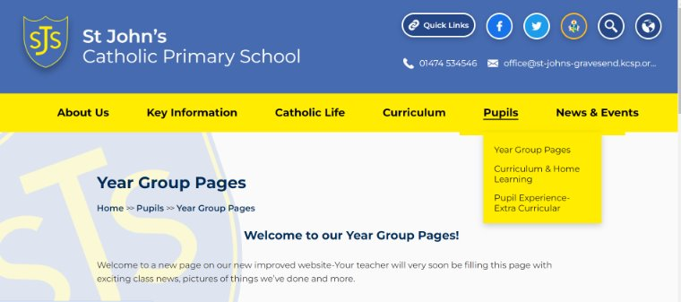
Our year group page
Please do visit our year group page where you will see what we have been up to and any information you may need.

Slide 13
Pupil Premium Eligibility
Your child may be eligible for free school meals - if you receive:​
Universal Credit and have an annual household income of £7,400 or less​
Support under part VI of the Immigration and Asylum Act 1999​
Income-related Employment and Support Allowance ​
The guaranteed element of Pension Credit ​
Your child might also qualify if you have no recourse to public funds (NRPF).​
​
New for 2026​
​
Expanded FSM – your child is eligible if you receive:​
Universal Credit – your income does not get taken into account.​
​
Pupils receiving expanded FSM:​
Can receive free school meals ​
Will not attract pupil premium funding for the school, nor be eligible for other support that’s based on targeted FSM ​
​
KCC website Online checker to see if you qualify: Apply for free school meals​

Slide 14
Volunteers
Are you able to volunteer at
St John’s?
We are currently building a team of volunteers.
The types of activities that volunteers are engaged in include:
Listening to children read
Working with small groups of children
Accompanying school visits
Displays and administrative tasks
Please contact the school office if you would like to become part of the team:
office@st-johns-gravesend.kcsp.org.uk

Slide 15

Questions

