Slide 1

Welcome to Year 4
Notes:
Include some images for your year group

Slide 2


The Team
Year Leader: Mrs Wilson
Class Teachers:
4SD– Mrs Wilson
4SP– Ms Collins
4SG– Mrs Burton/ Mrs Lynch
4SA– Mrs Mazzarelli
Support staff:
Mrs Reynolds and Ms Harding

Slide 3
Our day
8:35 – 8:45 Doors open
8:45 – 9:05 Celebration of the Word
9:05 – 10:10 – Maths
10:10 – 10:30 Reading
10:30 – 10:45 – Playtime
11:00 – 12:00 – English
12.00 - 12.30 - Curriculum
12.30 - 1.30 Lunchtime
1.30-3 - Curriculum
3:15 Hometime
PE DAY is Thursday
Notes:
PE – come to school in PE kit with swimming stuff in a bag

Slide 4
What will your children
be learning this year?
In Maths we follow the White Rose Curriculum. Challenge is a big focus in Maths and we encourage children to challenge themselves within lessons always.
There will be a focus on reading and children using their oracy to support their understanding of a text. It is incredibly important for children to practice reading with you, to support them in this.

Slide 5
Homework and
daily reading
In Year 4, homework is given out on a Friday and returned the following Wednesday.
Children are expected to read daily with an adult and have their reading record signed to reflect this.
Homework club will be on a Wednesday by invitation.
Children are also expected to complete at least 20 minutes of TTRockstars a week. They can access all the games but the best ones to practice without a timer is Studio, to get them ready for the MTC, Soundcheck is the closest version of the game. Teachers will monitor this and sometimes rewards may be given.

Slide 6
OPAL
Outdoor Play and Learning
During lunchtime children have access to OPAL.
Some of the activities on offer are:
Mud kitchen
Lego
Sports/games on the MUGA
Water play
Imaginative role play
Dress up
Physical exercise
Art
Board games
Activity area - gymnastics

Slide 7
Assessment
Assessment points are in Term 2, Term 4 and Term 6.
In preparation for the Year Four Times Table Check in June, there will be a strong focus on tables 1 to 12. Children are expected to practice using Time Tables Rock Stars as part of their weekly homework.

Slide 8
Trips, experiences and
key dates
There will be a Carol Concert held at St John’s Church at the end of Term 2.
Term 4 - Times table talk
Children will enjoy a trip to Wingham Wildlife Park during Term 6.

Slide 9
Expectations and
reminders
Homework is given out on a Friday. Children are expected to return their homework on Thursdays.
Reading record and book everyday.
PE Kit on Thursdays.
They may have ONE pencil case of standard size and shape.
Behaviour Policy

Slide 10
How can you support
at home?
Read daily with your child and sign the record to show that they have read, this is invaluable to their progress.
Homework club is available to invited children.

Slide 11
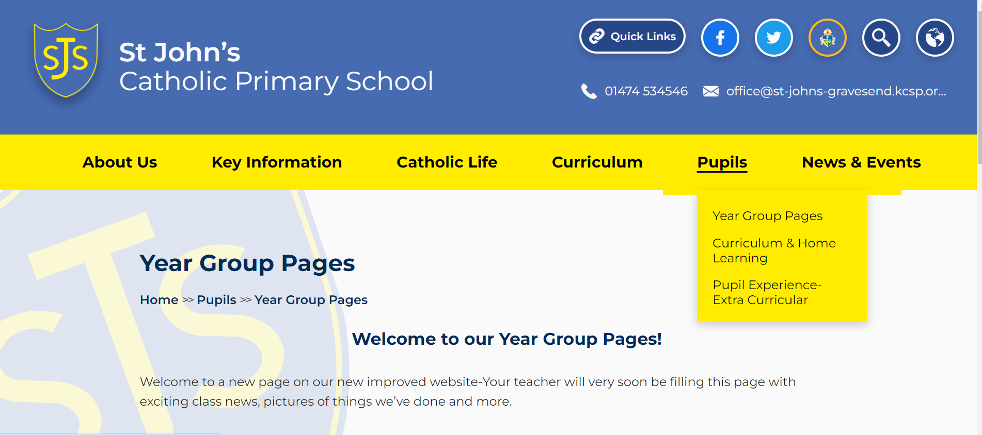
Our Year group page
Please do visit our Year group page where you will see what we have been up to and any information you may need!

Slide 12
Volunteers
Are you able to volunteer at
St John’s?
We are currently building a team of volunteers.
The types of activities that volunteers are engaged in include:
Listening to children read
Working with small groups of children
Accompanying school visits
Displays and administrative tasks
Please contact the school office if you would like to become part of the team:
office@st-johns-gravesend.kcsp.org.uk

Slide 13
Free School Meals
Targeted FSM – your child may be eligible if you receive:
Universal Credit and have an annual household income of £7,400 or less
Support under part VI of the Immigration and Asylum Act 1999
Income-related Employment and Support Allowance
The guaranteed element of Pension Credit
Your child might also qualify if you have no recourse to public funds (NRPF).
New for 2026
Expanded FSM – your child is eligible if you receive:
Universal Credit – your income does not get taken into account.
Pupils receiving expanded FSM:
Can receive free school meals
Will not attract pupil premium funding for the school, nor be eligible for other support that’s based on targeted FSM
KCC website Online checker to see if you qualify:

Slide 14

Questions

